Slide 1
Tables

Slide 2
Typical Uses of Tables
Regular Layout
Present content in a table, i.e., tabular or columnar format
Irregular Layout
Position content in irregular ways
Requires column and/or row spanning

Slide 3
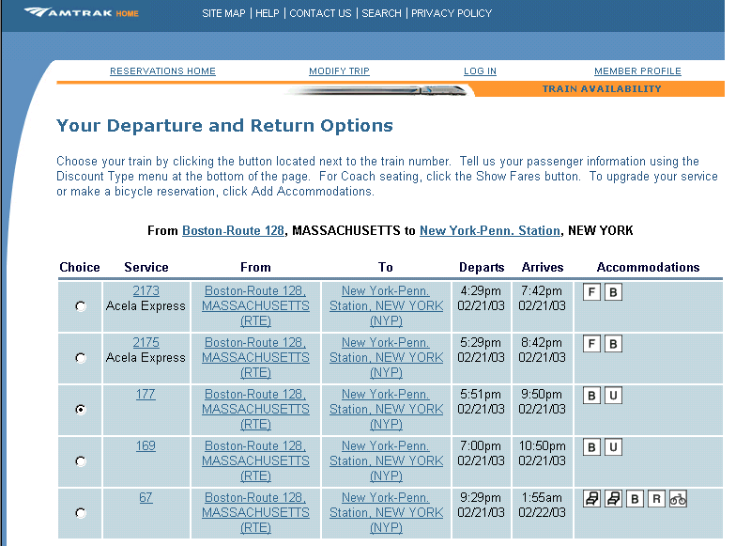
Regular Layout Example
A table is being
used to present this schedule information in an easy-to-read format.

Slide 4
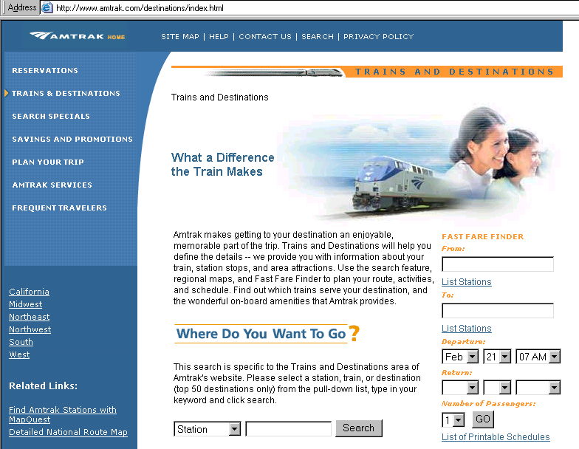
Irregular Layout Example
A table is being
used to layout or arrange these text and image objects

Slide 5
HTML Table Tags
<table>…</table>
Defines table object
<tr>…</tr>
Defines table row
<td>…</td>
Defines table cell
In HTML, table columns are not explicitly defined. They are defined as a by-product of defining table cells.

Slide 6
Nesting Table Tags
Table Row
Table Cell
<table> <tr><td>…</td><td>…</td></tr> <tr><td>…</td><td>…</td></tr> </table>
Table

Slide 7



Regular Tables
<table>
<tr><td>1</td><td>2</td></tr>
<tr><td>3</td><td>4</td></tr>
</table>
<table>
<tr><td>1</td><td>2</td></tr>
<tr><td>3</td><td>4</td></tr>
<tr><td>5</td><td>6</td></tr>
</table>
<table>
<tr><td>1</td><td>2</td><td>3</td></tr>
<tr><td>4</td><td>5</td><td>6</td></tr>
</table>

Slide 8
Table Activity
Copy RegularTables.htm from Canvas to your laptop
Add a column to one of the tables by adding <td>some text</td> to each row
Add a row to one of the tables

Slide 9
Irregular Tables
Irregular tables have cells that cross over one or more rows or columns
For a cell that covers two or more columns, use <td colspan="x">data</td>, where x is the number of columns spanned
For a cell that covers two or more rows, use <td rowspan="x">data</td>, where x is the number of rows spanned

Slide 10


Irregular Tables Using colspan
<table>
<tr><td>1</td><td>2</td></tr>
<tr><td colspan="2">3</td></tr>
</table>
<table>
<tr><td>1</td><td>2</td><td>3</td></tr>
<tr><td>4</td><td colspan="2">5</td></tr>
<tr><td colspan="3">6</td></tr>
</table>

Slide 11
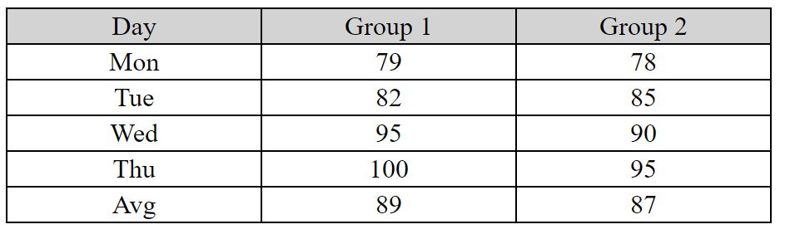
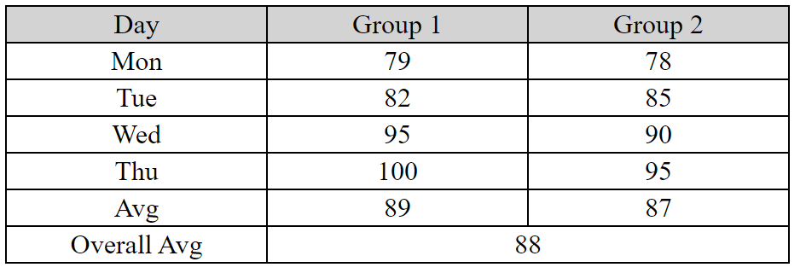
Colspan Table Activity
Copy DoColspan to your laptop from Canvas
Add a line to the table to show the overall average (see below)

Slide 12


Irregular Tables Using rowspan
<table>
<tr><td>1</td>
<td rowspan="2">2</td></tr>
<tr><td>3</td></tr>
</table>
<table>
<tr><td>1</td><td>2</td>
<td rowspan="3">3</td></tr>
<tr><td>4</td><td rowspan="2">5</td></tr>
<tr><td>6</td></tr>
</table>

Slide 13
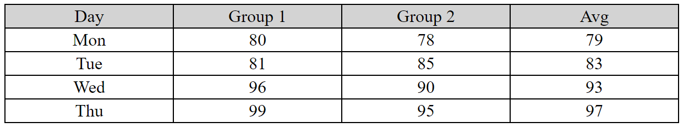
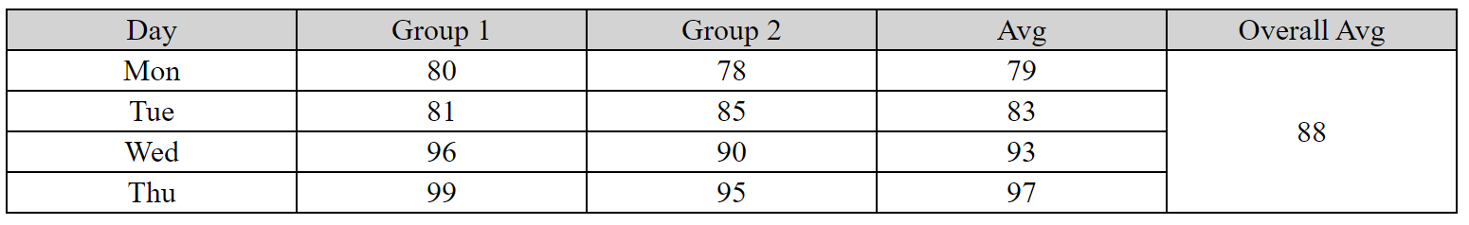
Rowspan Table Activity
Copy DoRowspan.htm to your laptop from Canvas
Add a column to show the overall average (see below)

Slide 14

Irregular Table Example with rowspan and colspan
<table>
<tr><td>1</td><td colspan="2">2</td></tr>
<tr><td rowspan="2"> 3</td><td>4</td><td>5</td></tr>
<tr><td>6</td><td>7</td></tr>
</table>

Slide 15
Irregular Tables with WYSIWYG Editors
Usually, you can create irregular tables in WYSIWYG editors with the "merge cells" command

Slide 16
Irregular Layout Example
Irregular tables often blend images and text. Generally they don’t use borders.

Slide 17
Nesting Tables
Outer Table
2 rows, 1 column
Inner Table
2 rows, 2 columns

Slide 18
Nesting Tables
<table>
<tr><td>…</td></tr>
<tr><td>
<table> <tr><td>…</td><td>…</td></tr> <tr><td>…</td><td>…</td></tr>
</table>
</td></tr>
</table>
Inner
Table
Outer Table

Slide 19
Styles for Tables
The table tag supports all styles
The td tag does not support margin and positioning styles. Use padding.
The tr tag seems to support only background, font, and text styles

Slide 20
Styles for Tables
To center a table on a page
table {margin-right:auto; margin-left:auto; width:x%}, where x is not 100
To create a grid
td {border:1px solid black}*
table {border-collapse:collapse}
* Of course, you can use any size, style, or color; this is just an example

Slide 21
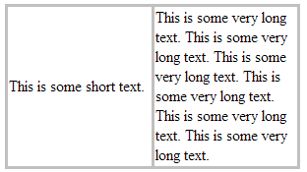
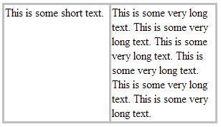
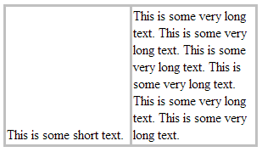
Styles for Tables: vertical-align
td {vertical-align:middle} or
no use of vertical-align style
td {vertical-align:top}
td {vertical-align:bottom}

Slide 22
Creating Tables with CSS
Place columns in <div>s that float left
Can specify width of columns to be same or different
Can break columns into sub-columns by floating <p>s or <div>s inside them

Slide 23
Advanced Table Formatting

Slide 24
Caption (New to HTML5)
<caption></caption> can be used to title a table
Must be first item in <table>
Appears only in first page printed or shown

Slide 25
Column Groups
span="2"
span= "1"
You may define column groups in order to specify styles (only border, background, width and visibility) for one or several columns.
Assume a table with 3 columns: <colgroup span="2" class="c1"></colgroup> <colgroup span="1" class="c2"></colgroup>
Starting on the left, columns 1 and 2 have class c1 (perhaps red bg) and column 3 has class c2 (perhaps blue bg).

Slide 26
Table head, body, and foot
If specified, head and foot will appear on each page of a printed table
Tags are <thead> <tbody> and <tfoot>
Each needs a closing tag
Must appear in order shown, and after colgroups if they exist
If <thead> or <tfoot> is used, they must all be used, although they may be empty
Use <tr> and <td> inside each, although can replace <td> by <th> inside <thead>
Each can have multiple lines (<tr>)

